Slide 1
New Student Information
Come Join Our Family!!!!

Slide 2
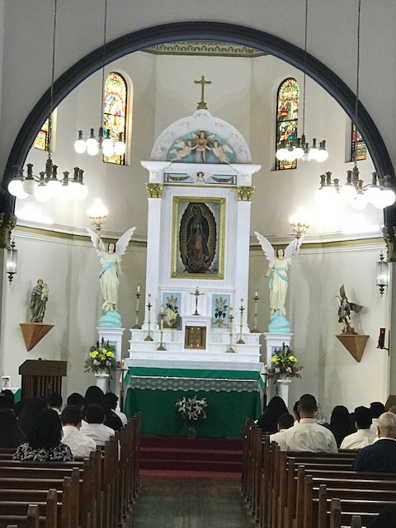
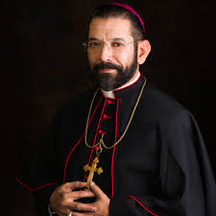
GRMS Principal-Dr. Virginia G. Miller
Established in 2002

Slide 3
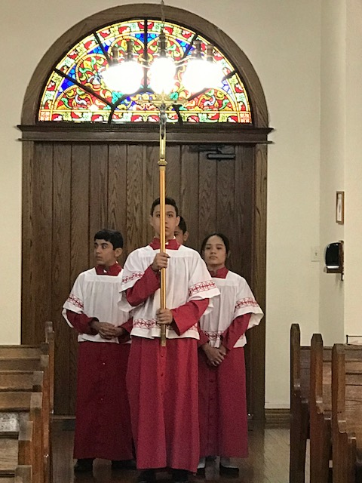
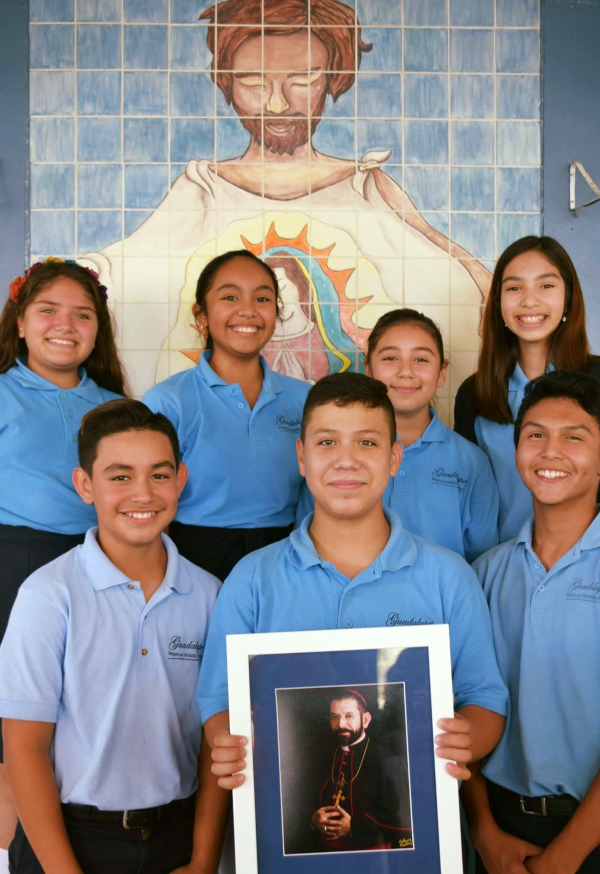
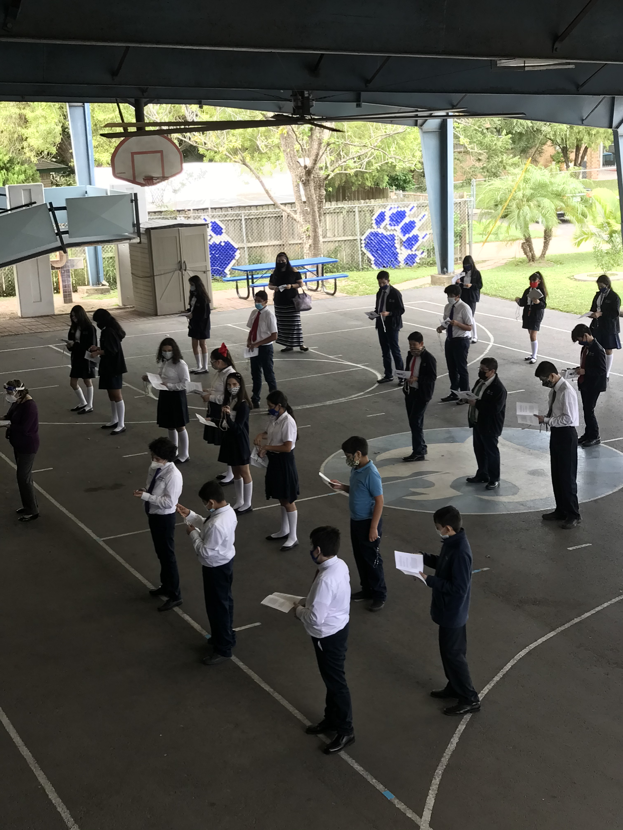
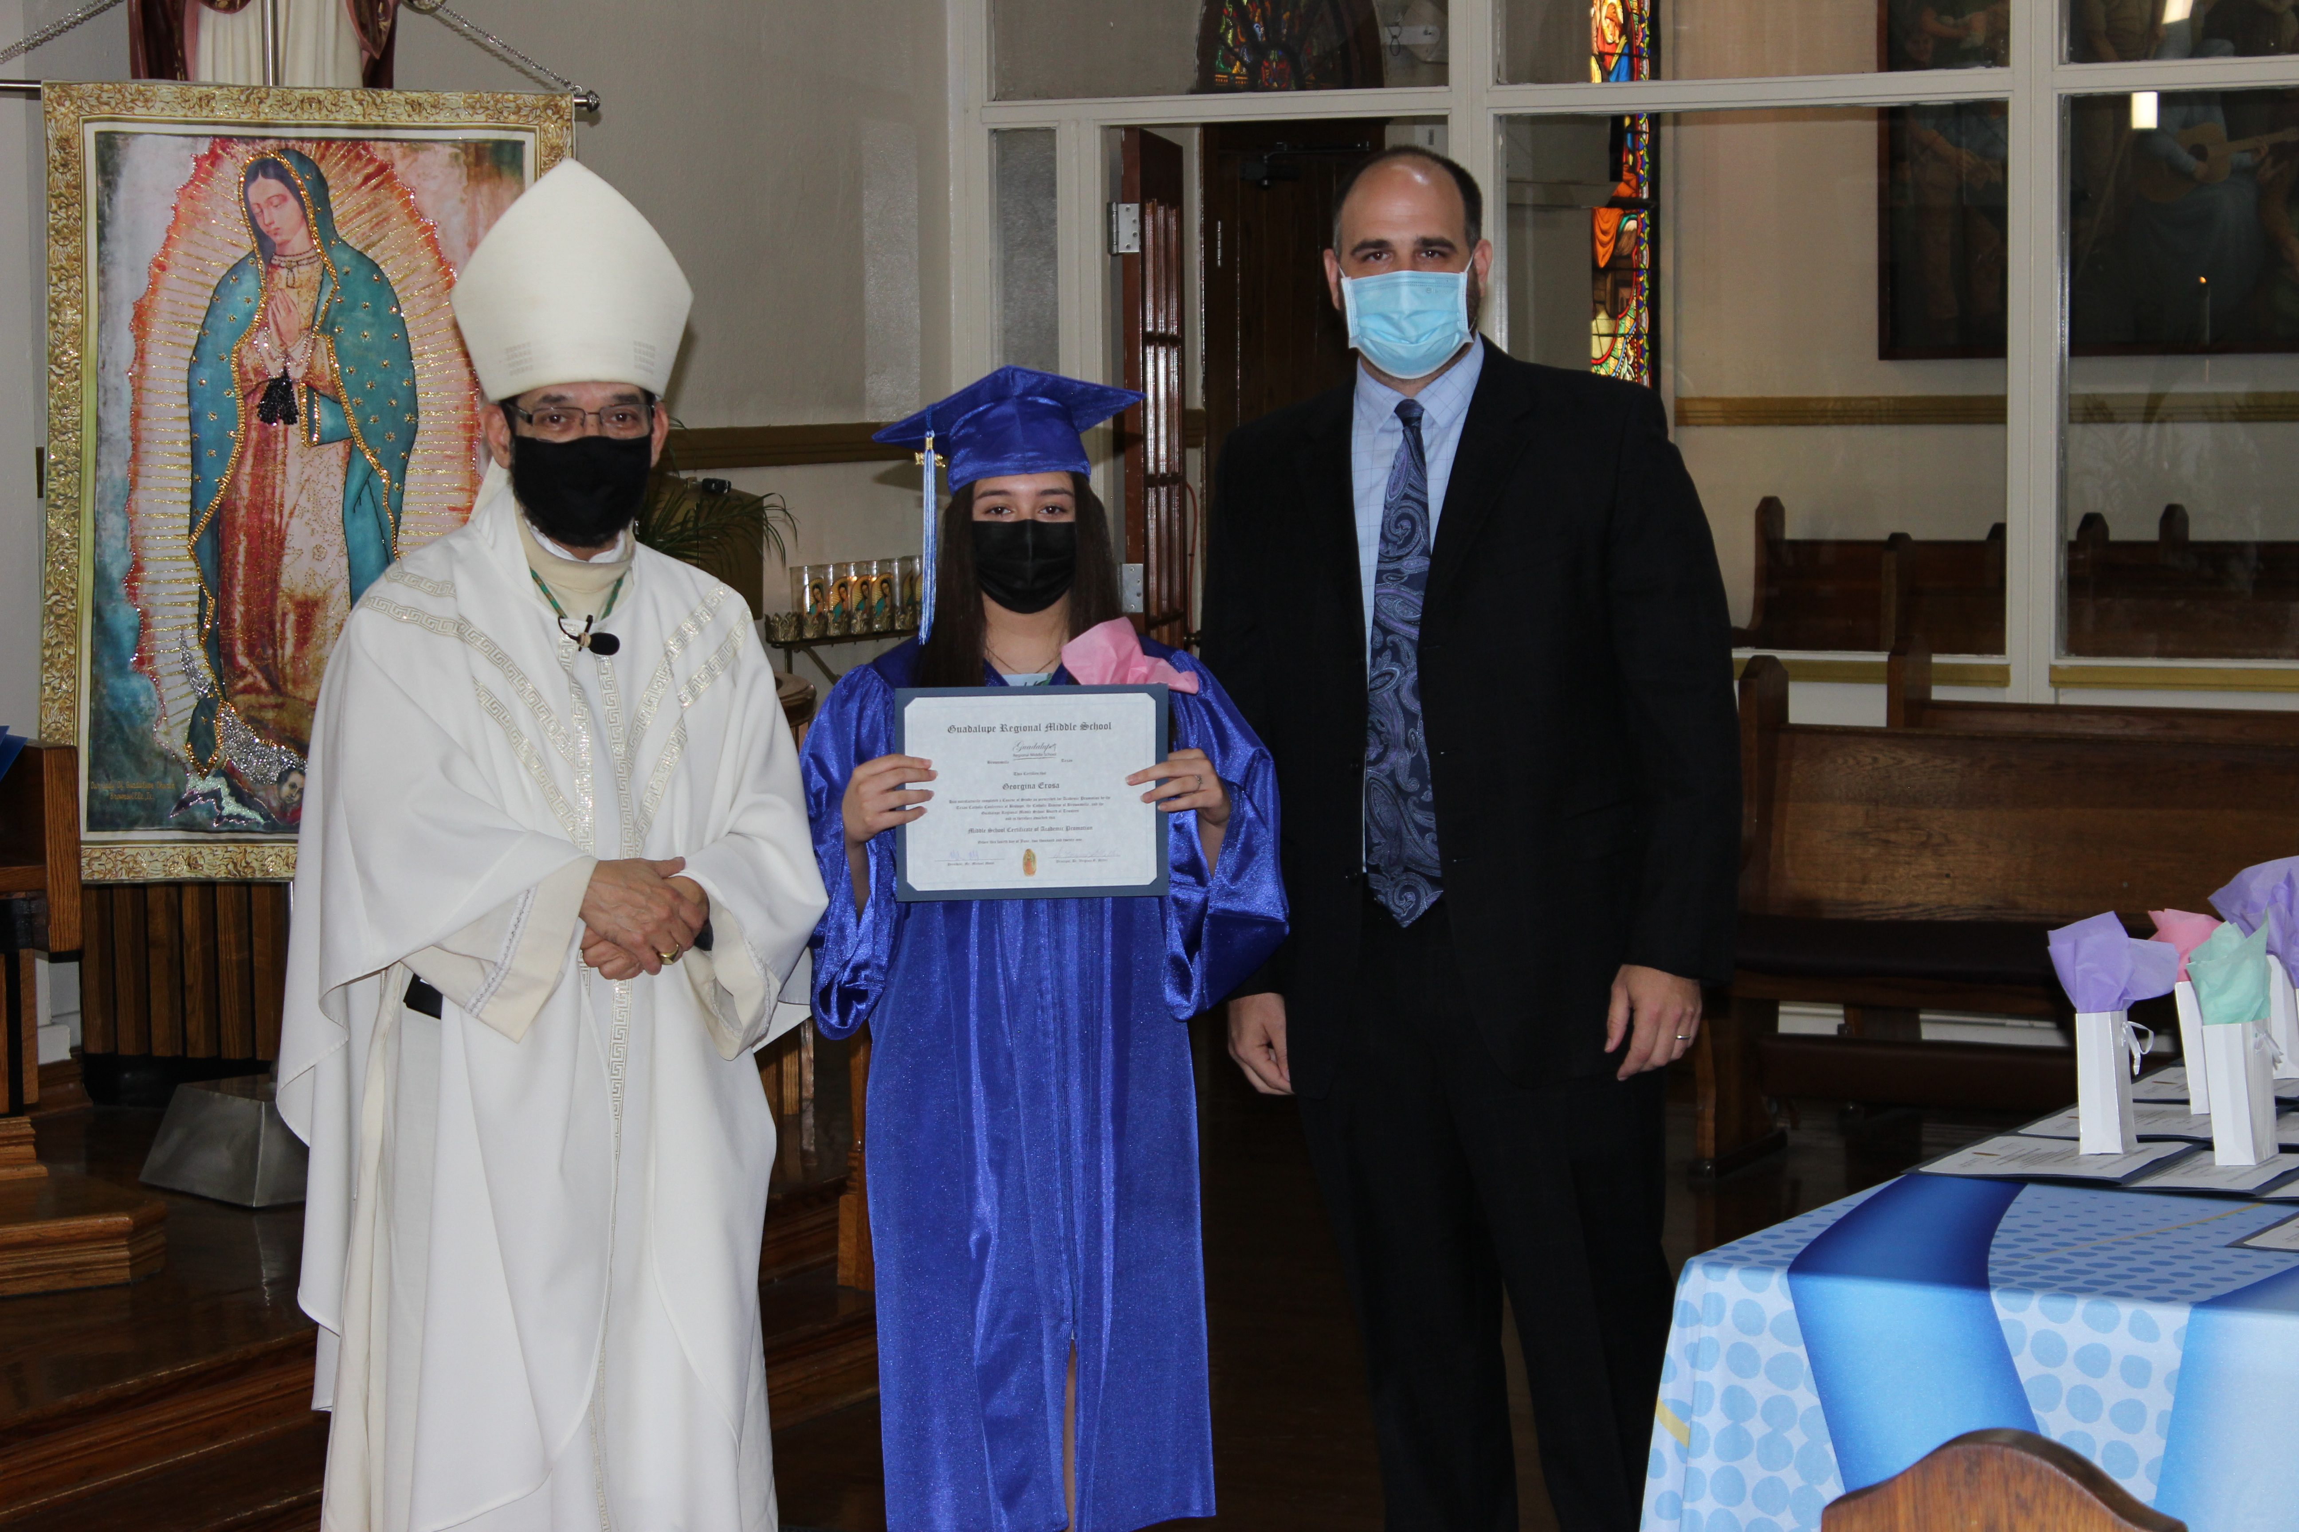
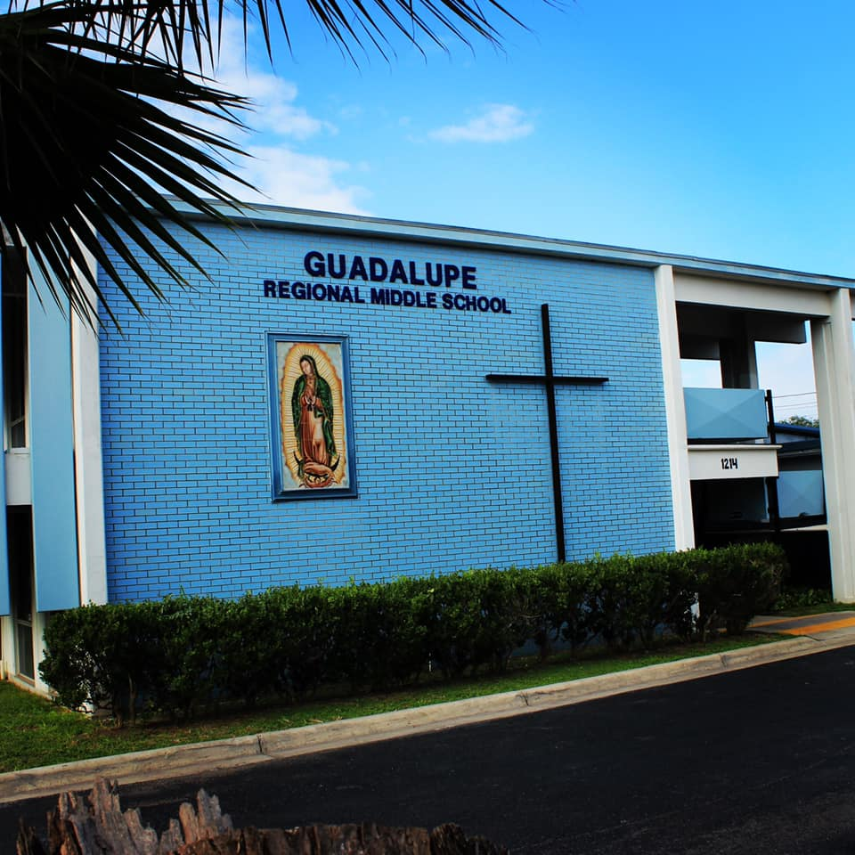
Guadalupe Regional Middle School Catholic Middle School All Scholarship Boys & Girls Grades 6, 7, and 8th
Our Lady of Guadalupe Church
1214 Lincoln Street
Brownsville, TX 78521
956-504-5568 office

Slide 4
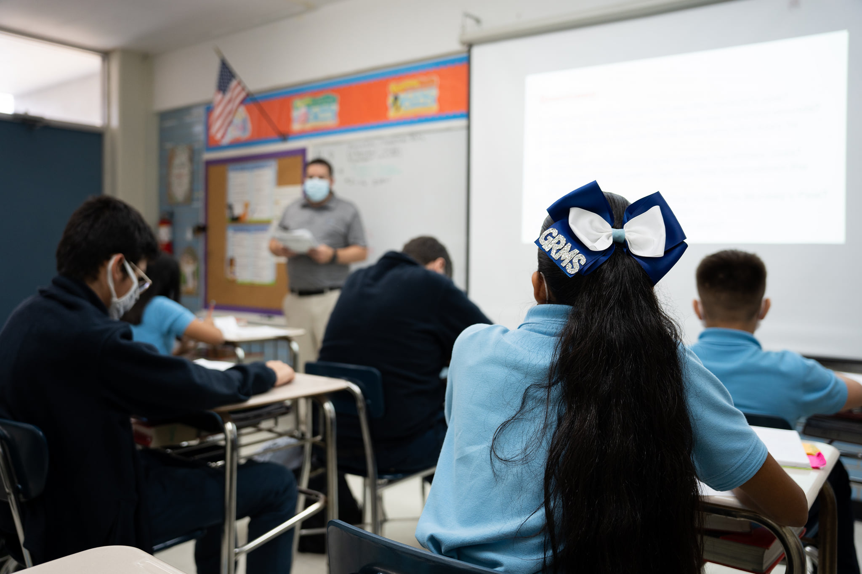
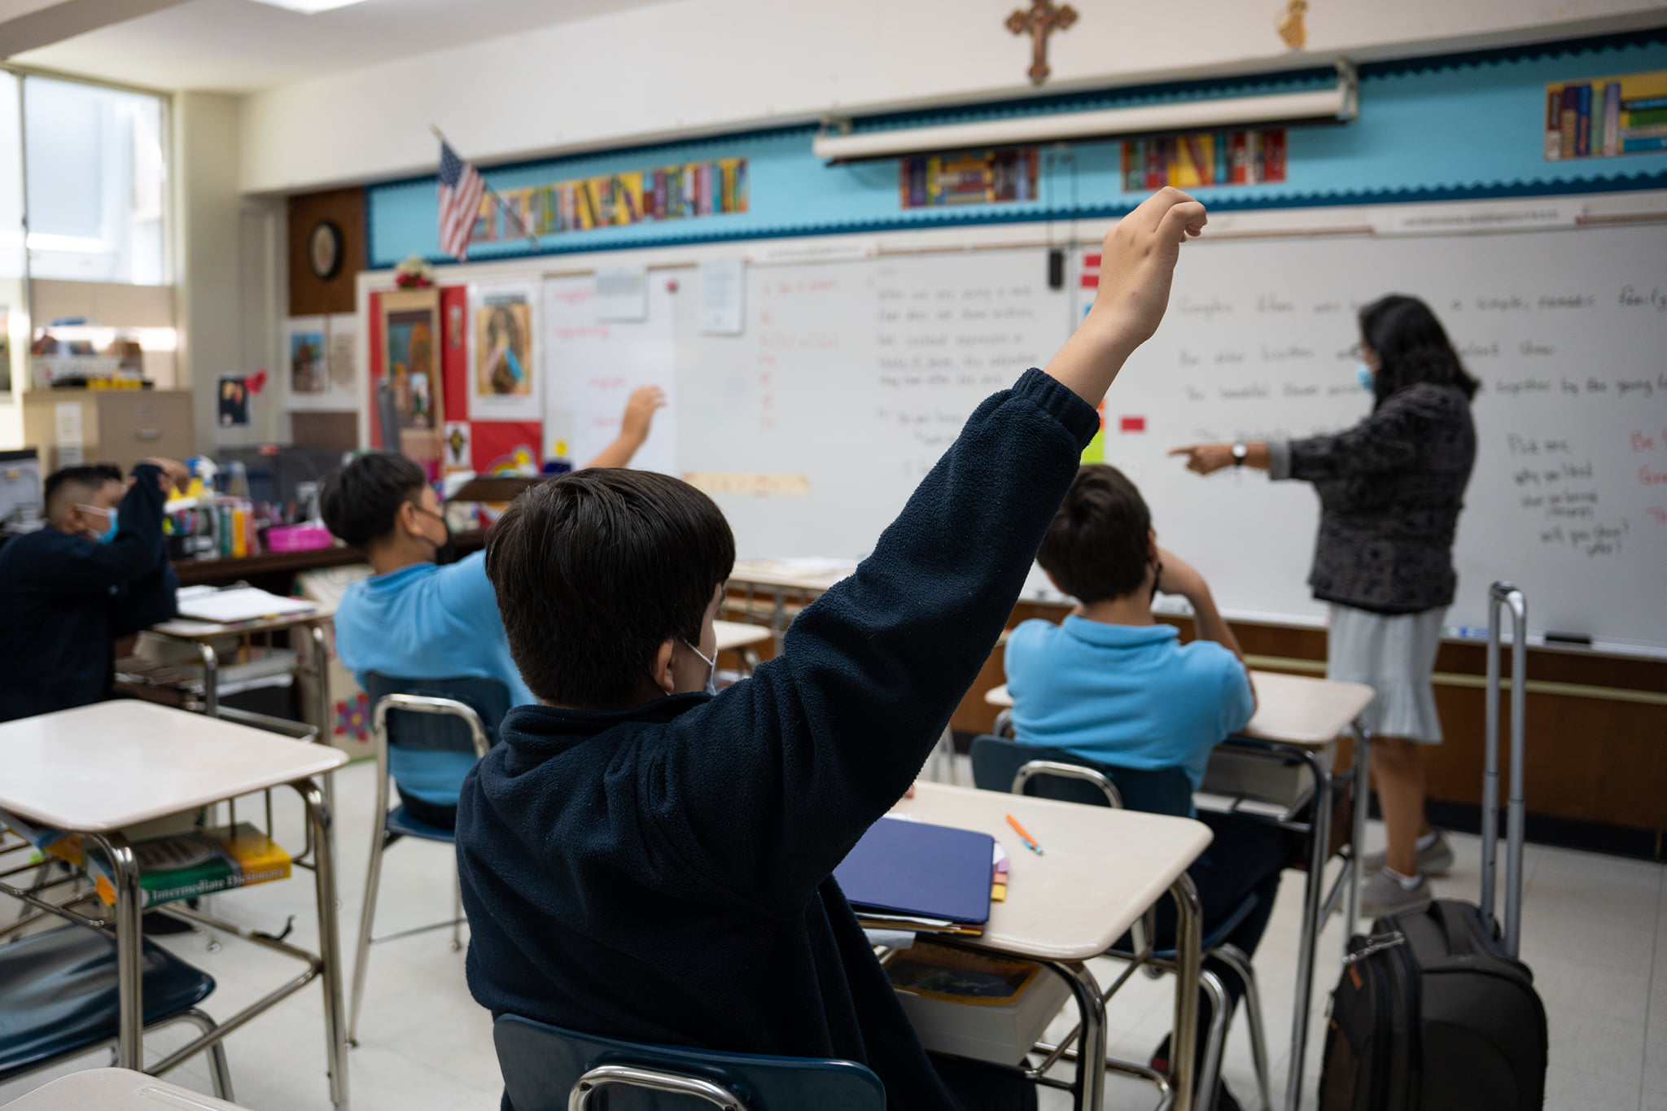
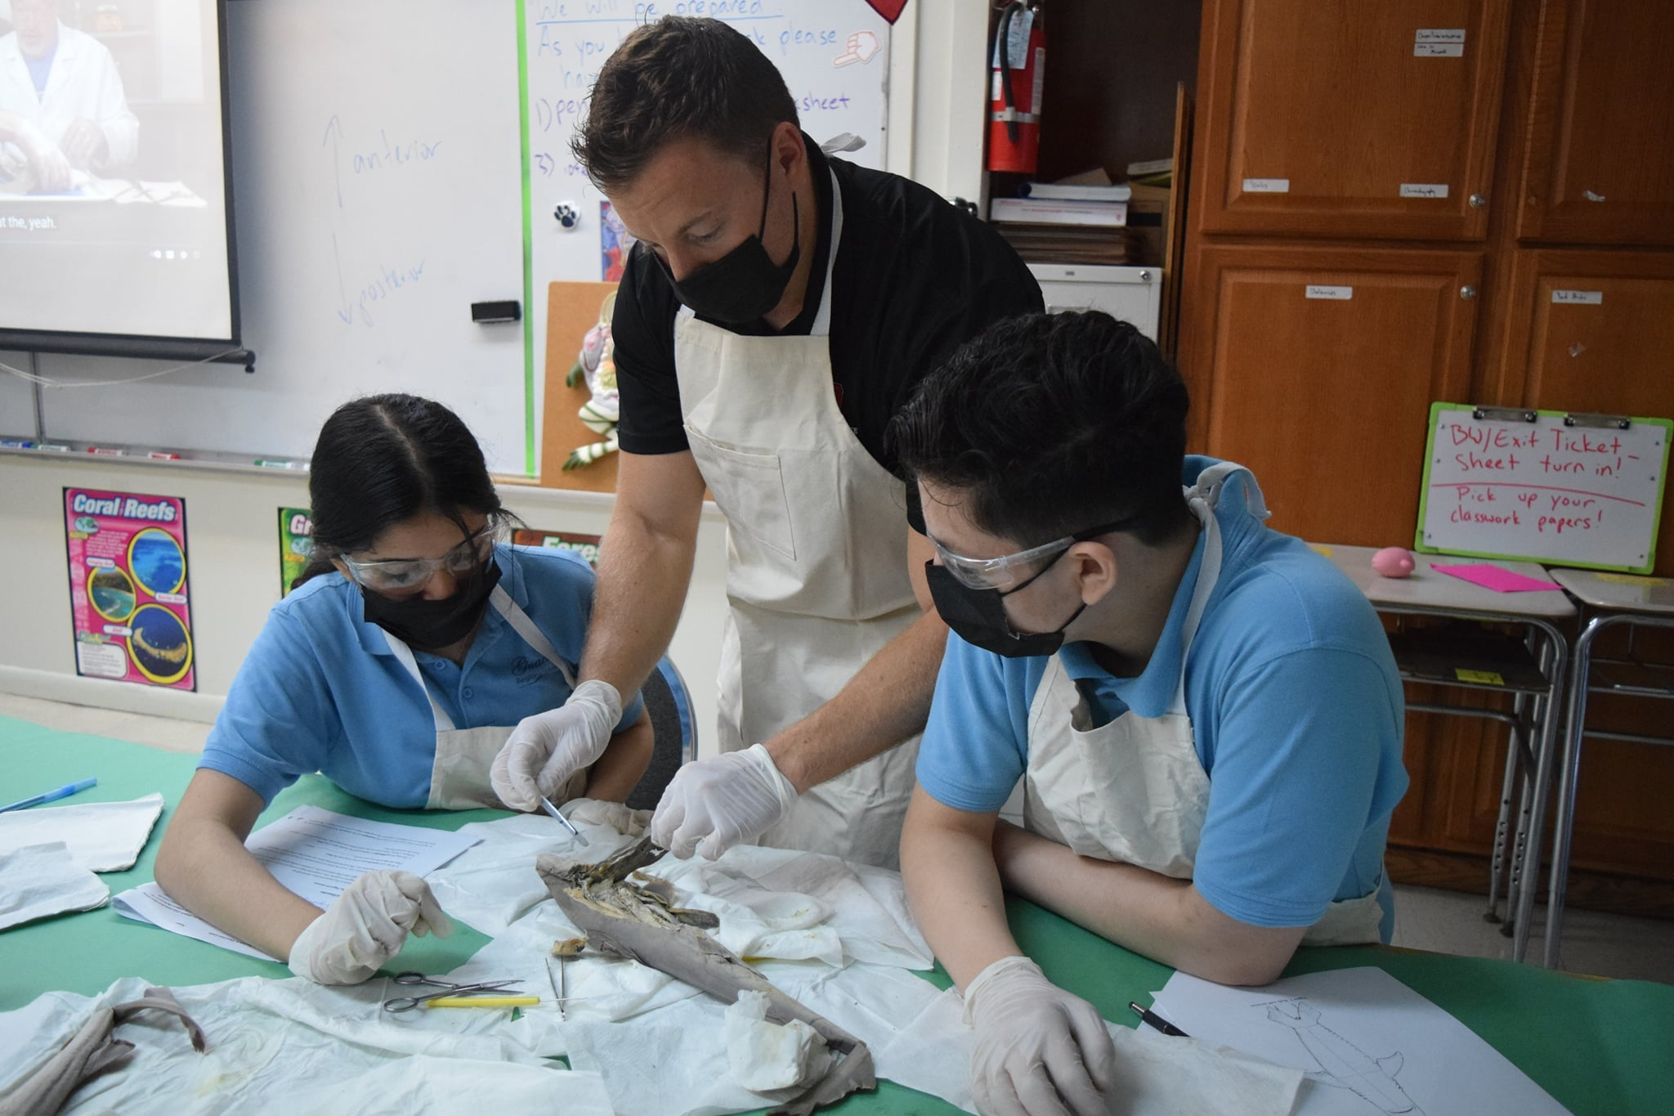
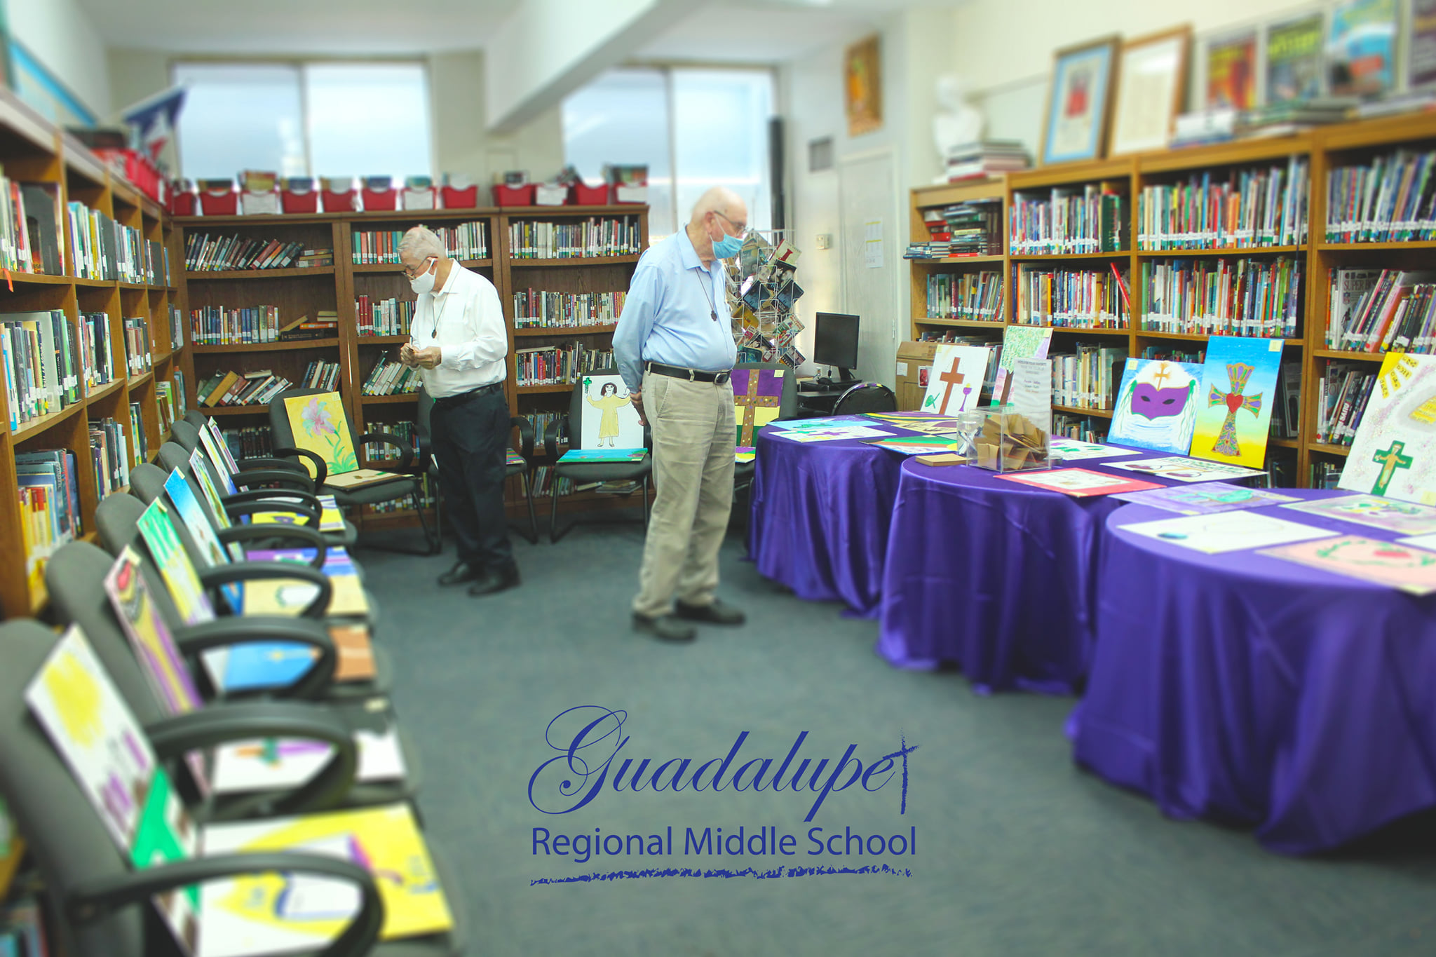
Monday-Fridays English Math Science Social Studies Religion Technology Physical Education

Slide 5
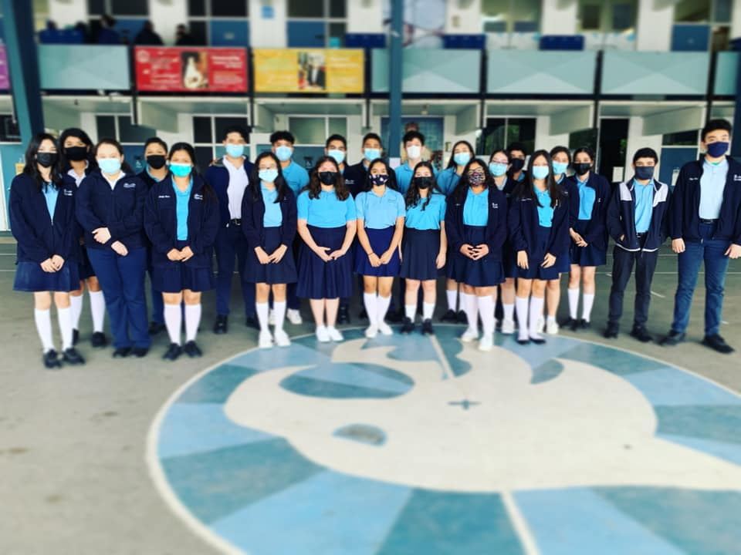
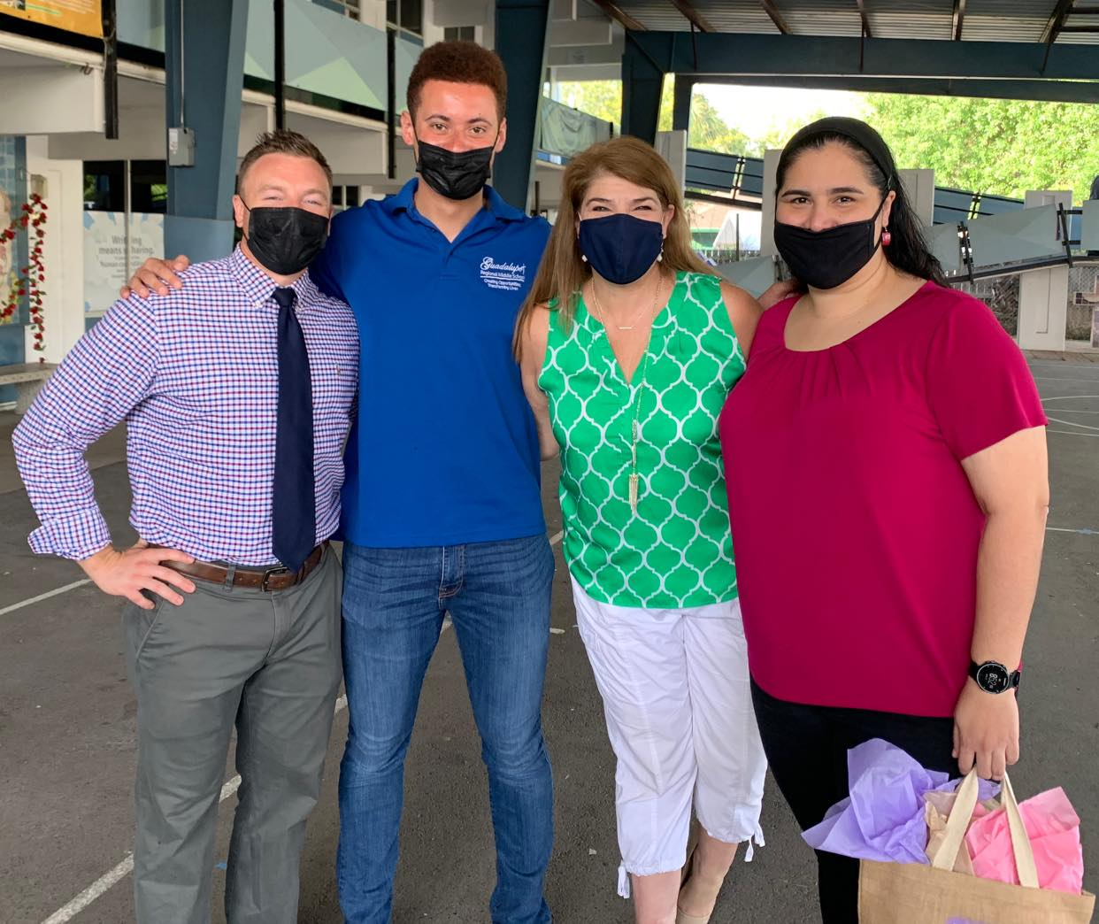
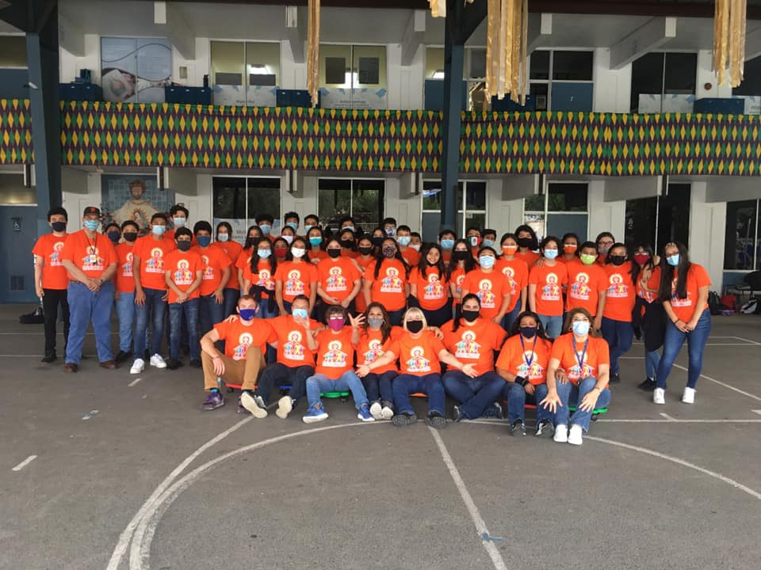
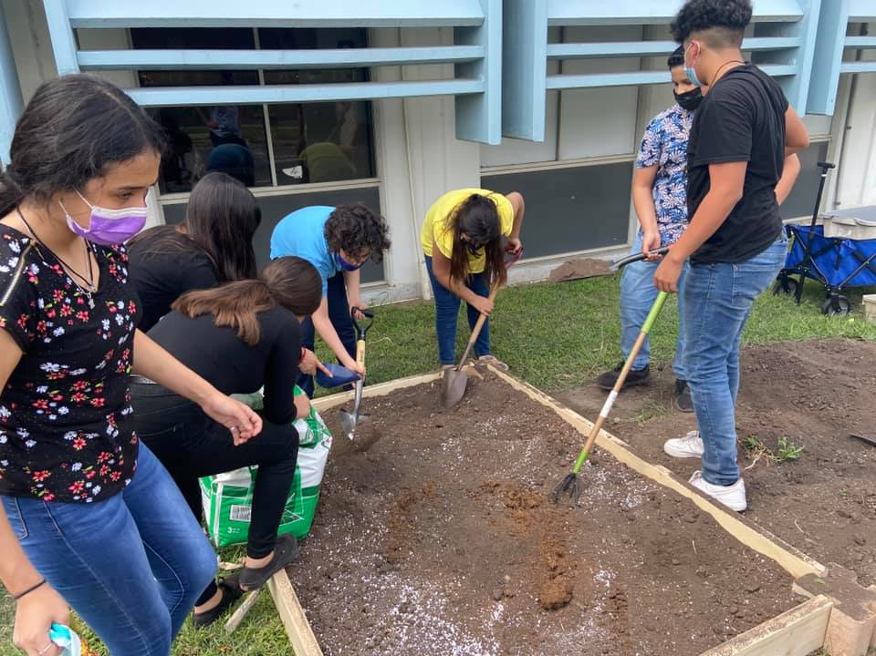
Classes Study Period Activities
8:00 AM to 4:30 PM
7 Classes
Study Period
Activity Period
Mass on Fridays

Slide 6
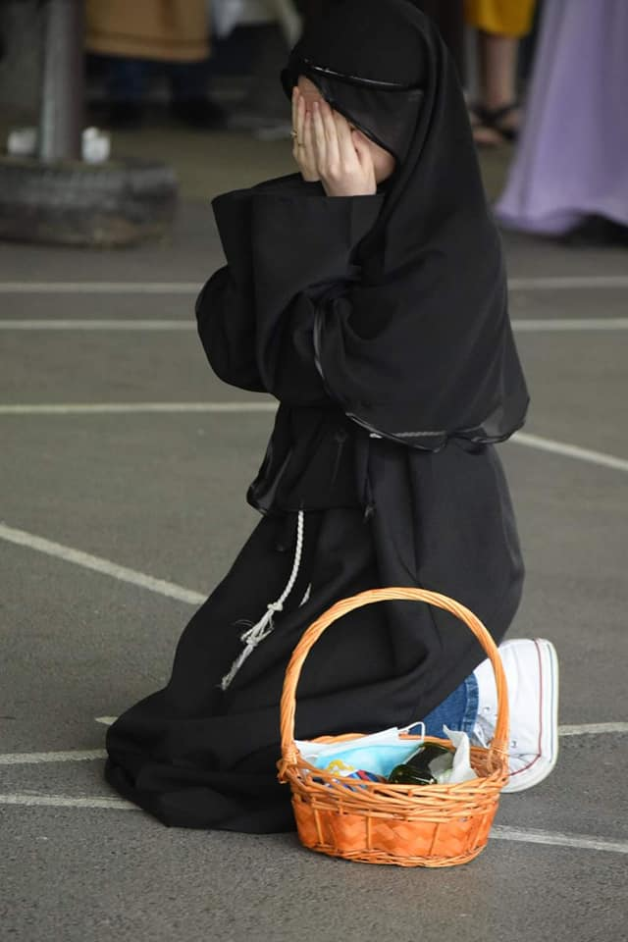
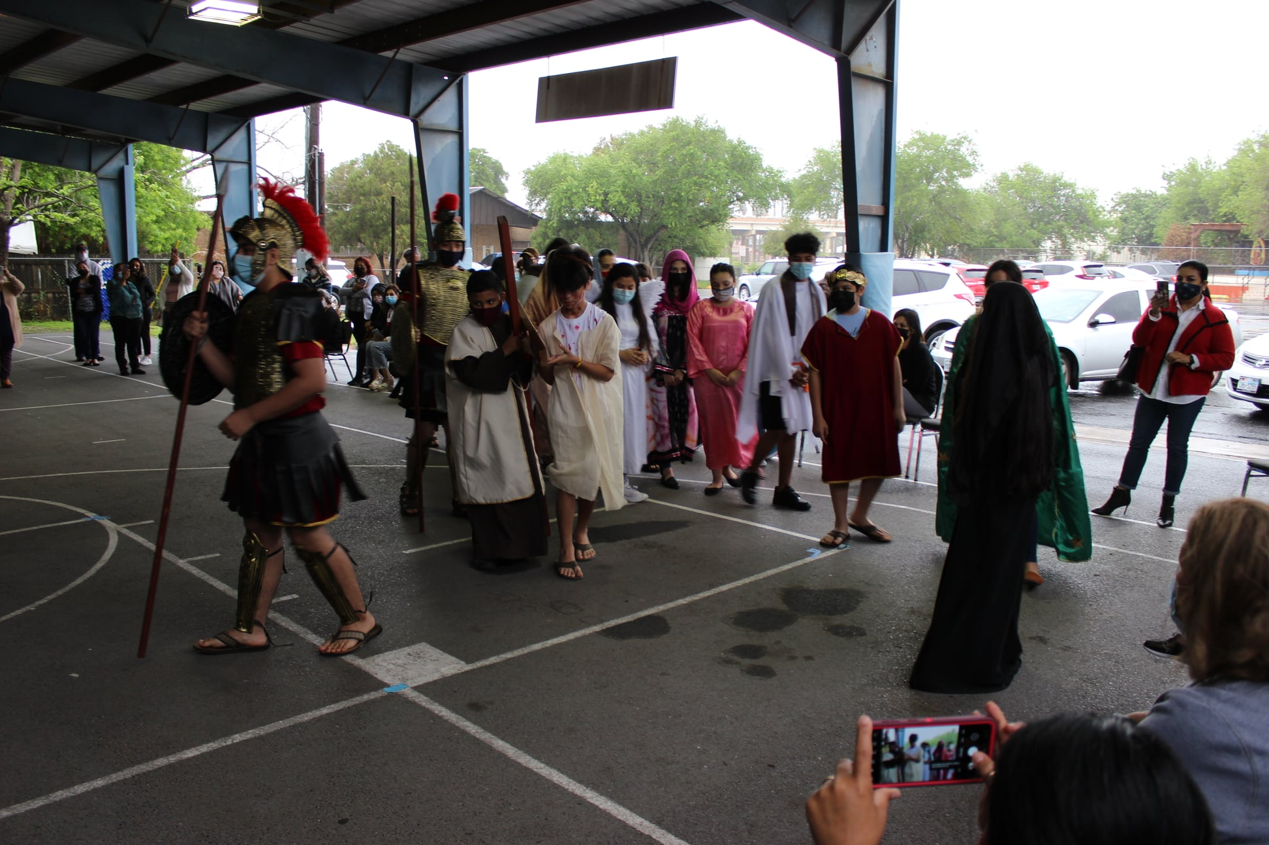
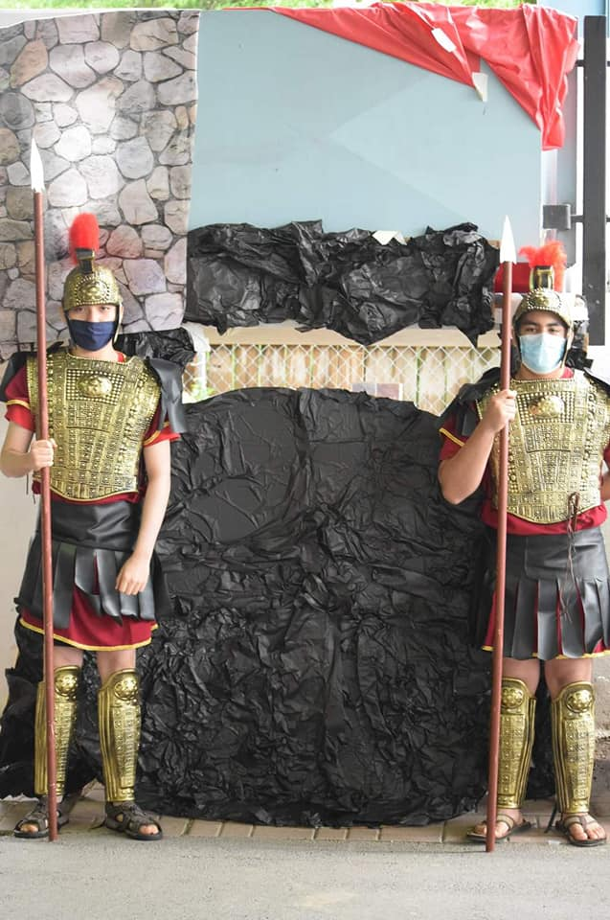
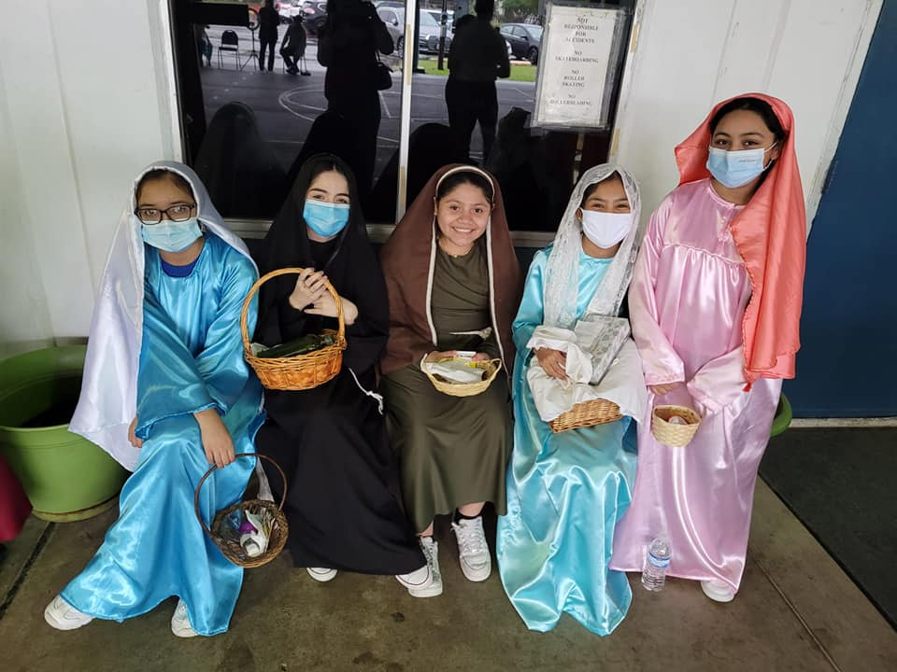
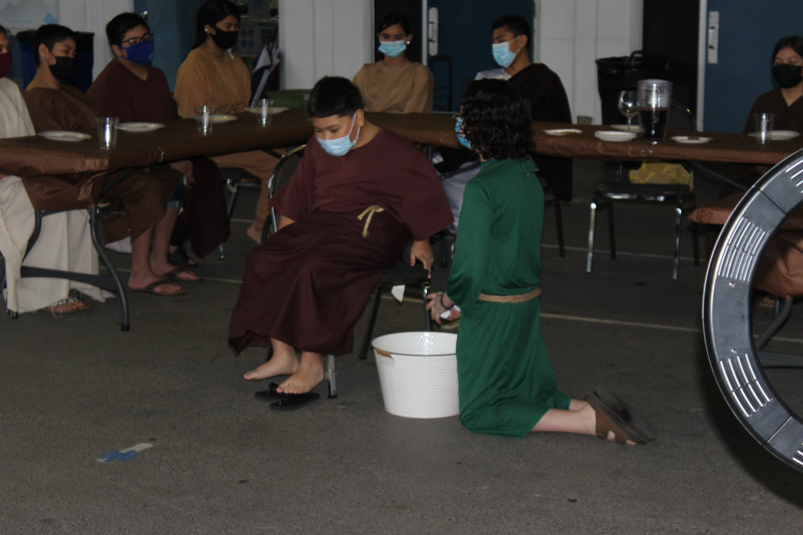
Faith Formation Daily Religion Classes Weekly Mass Student Mass Living Gospels Rosary Prayers

Slide 7
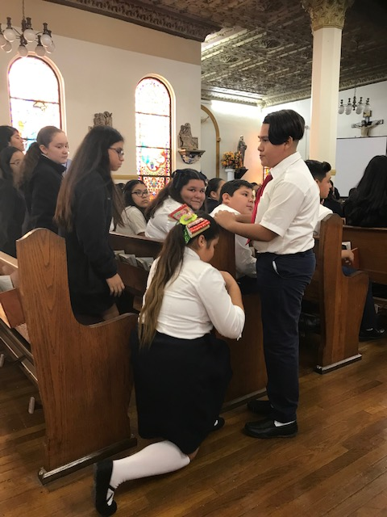
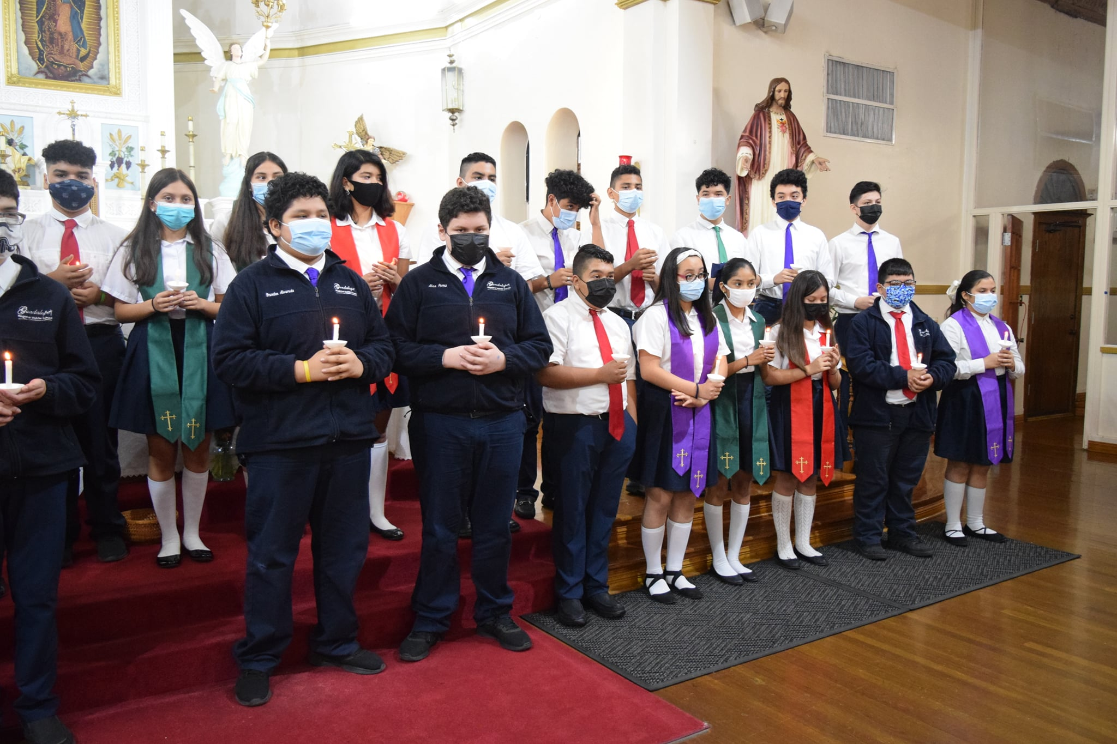
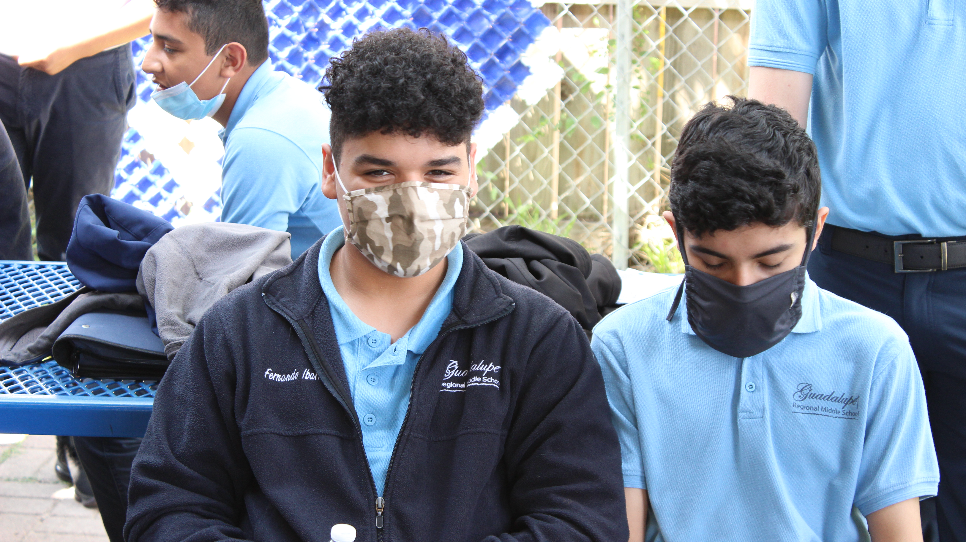
Parent & Family Commitment
Transportation
Lunch
Parents Drop Off & Pick Up Students Everyday
Students can walk to/from school with Parent Permission
Students bring their own lunch to school
Food Baskets are sent home every Friday
School Uniforms
Students wear School Polo Shirt & Blue pants/skirts
PE uniform of Tshirts and Shorts
Mass Attire, white shirts, blue bottoms, dress shoes

Slide 8
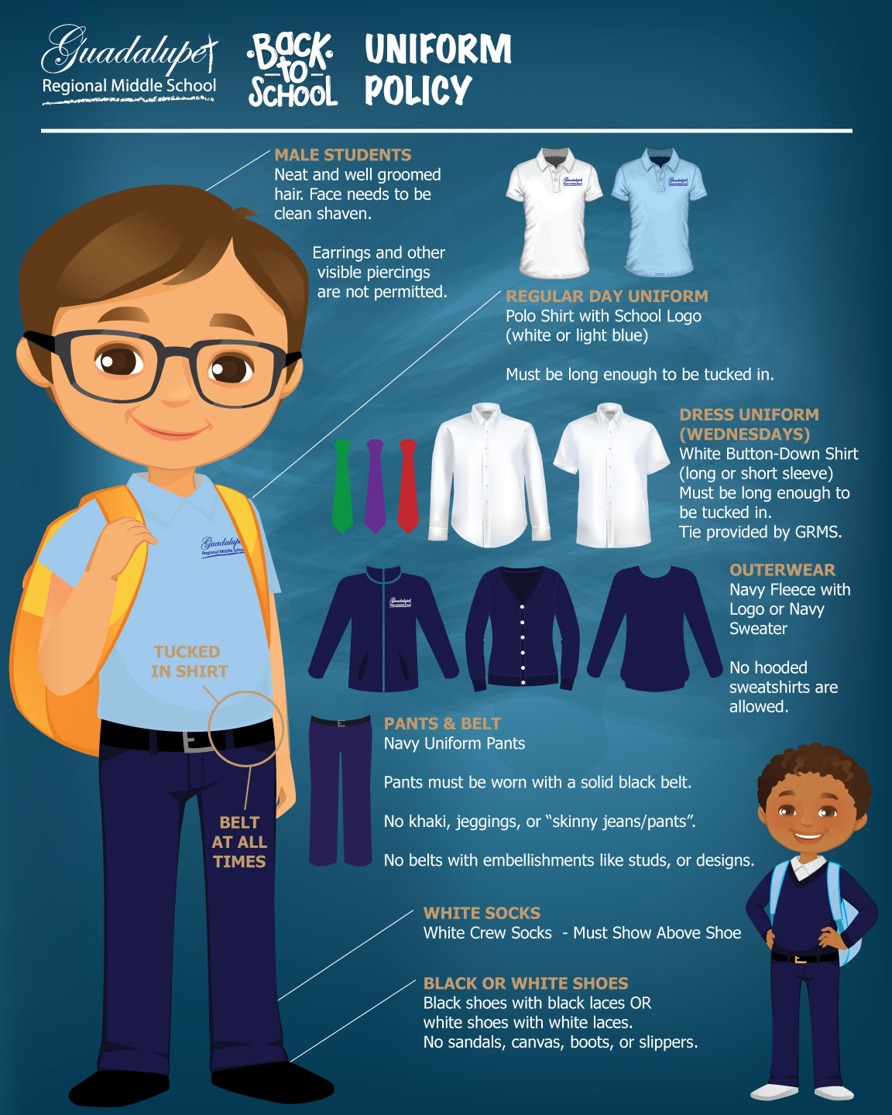
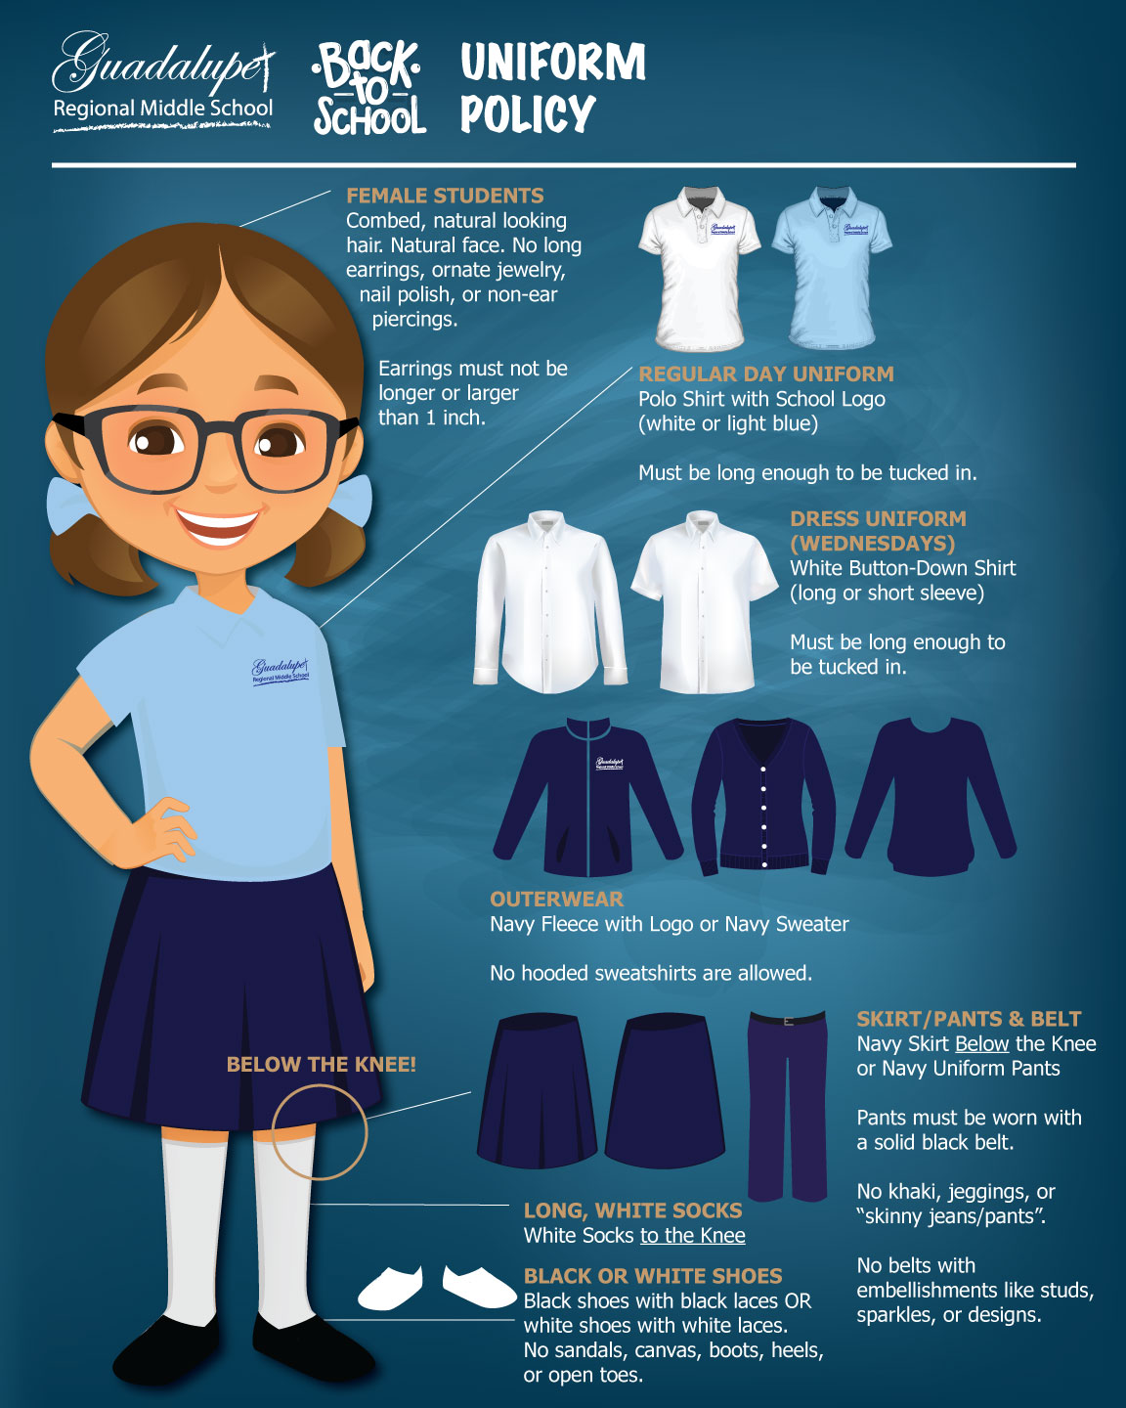

Slide 9
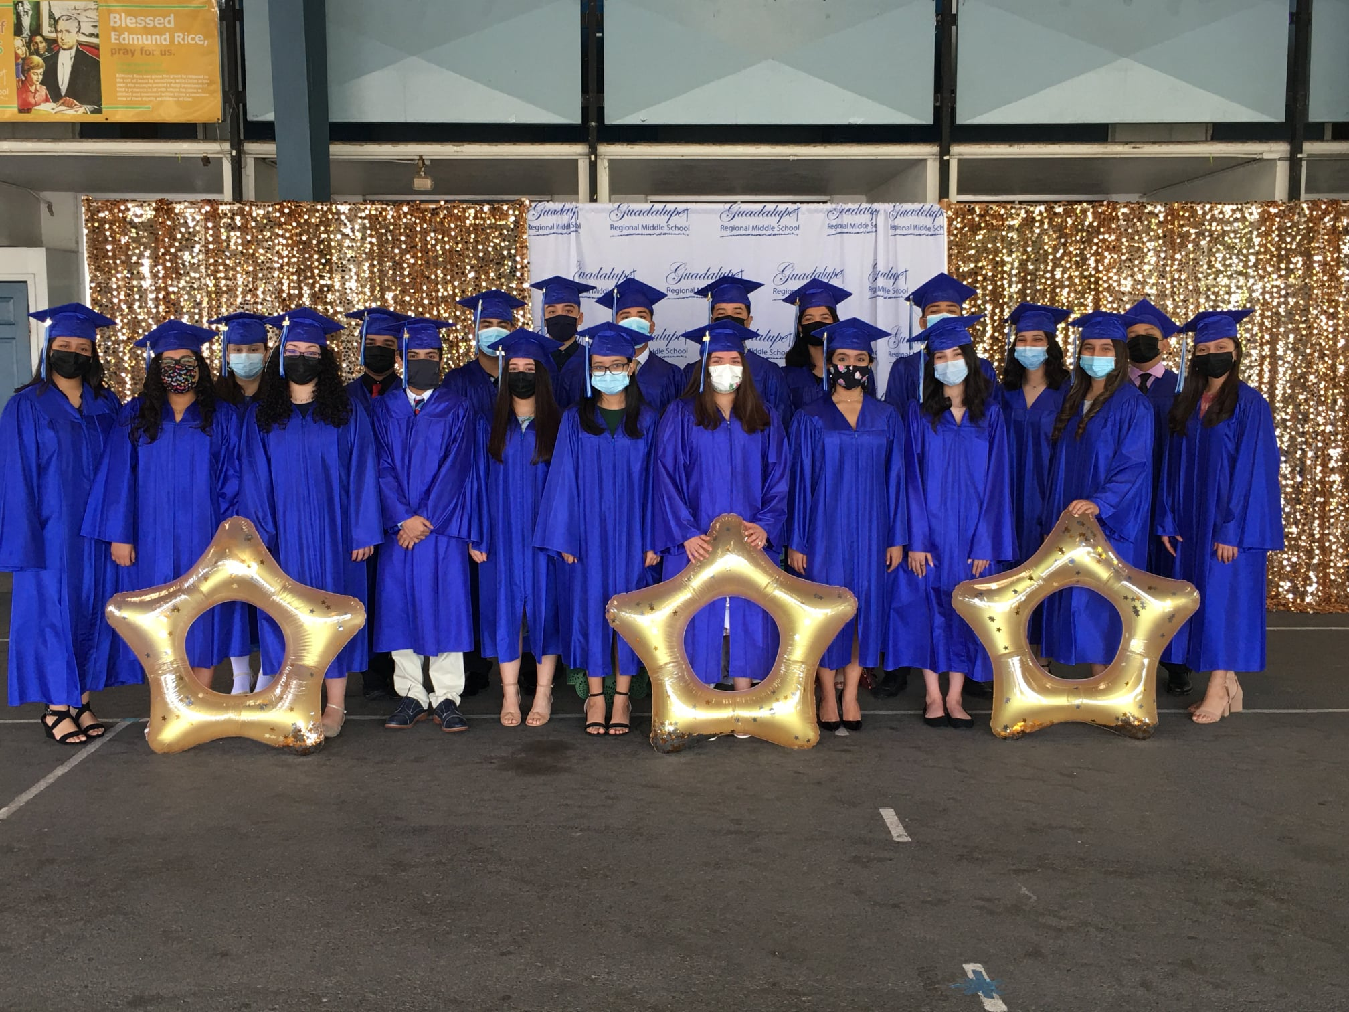
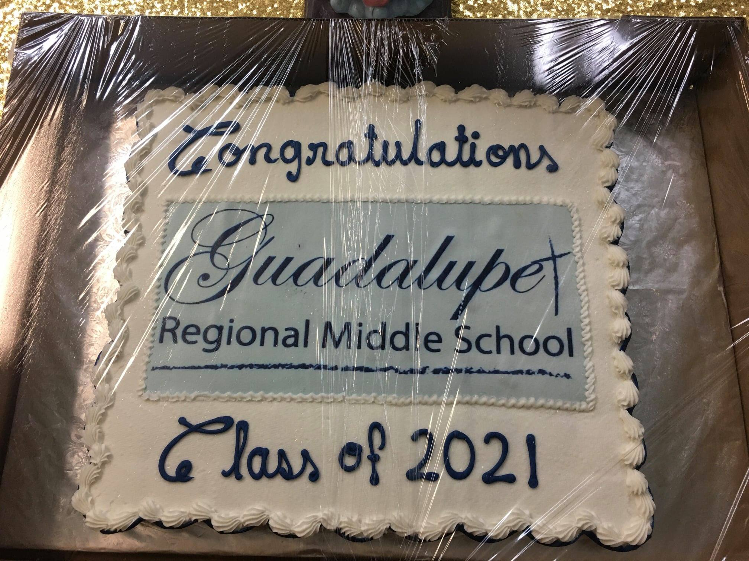
Apply Now
Application
Entrance Exam
Begin in January!!!!

Slide 10
www.guadalupeprep.org
Facebook
Instagram
Twitter
Student Enrollment Applications are available in English and Spanish on our website, or in our front office.
956-504-5568

